Slide 1


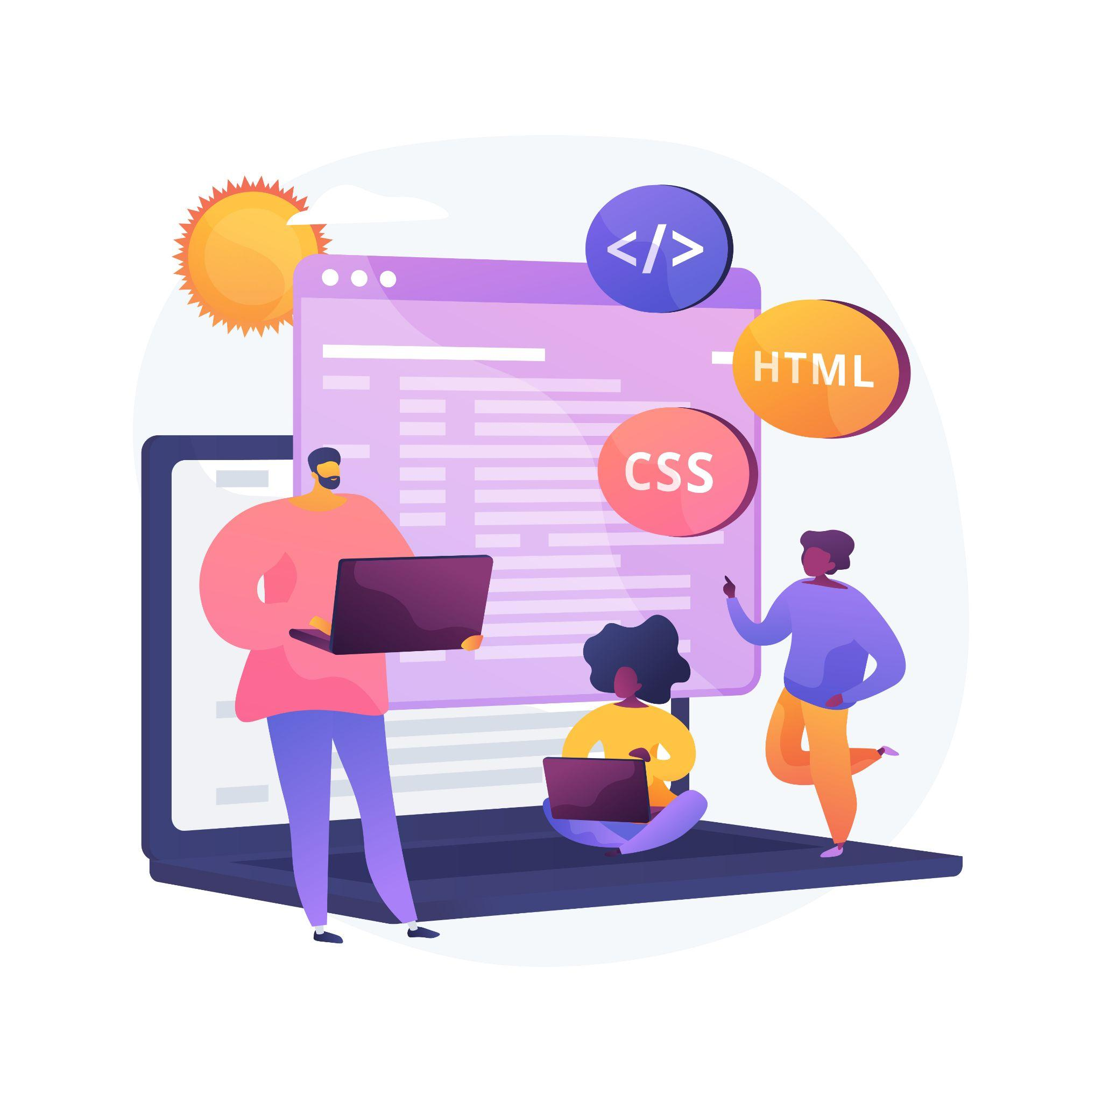
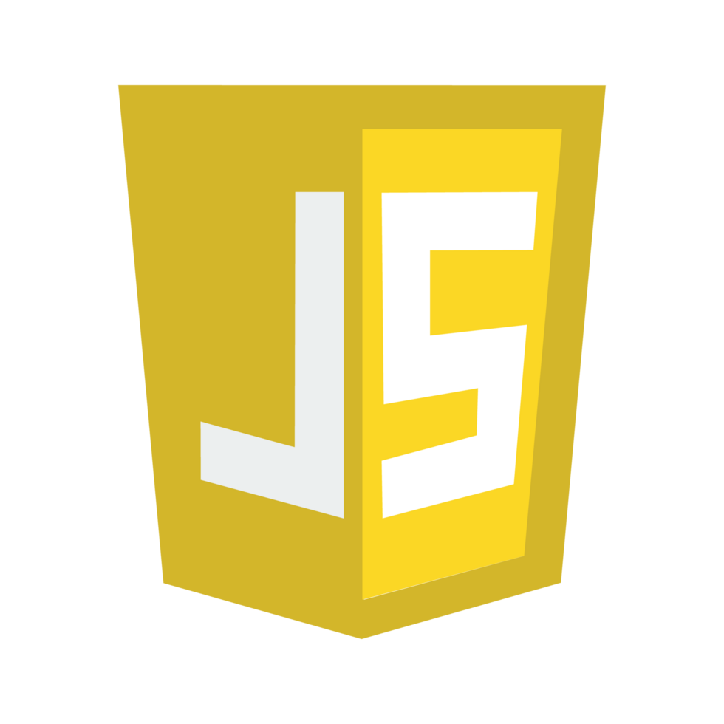


Lecture 9:
Need for Asynchronous JS
Course - Web Development - II
-By
Instructor Name
‹#›
welcome@krmangalam.edu.in
Sohna Road,Gurugram,Haryana 122103

Slide 2

| Table of Contents
Synchronous Programming in JavaScript
Asynchronous Programming in JavaScript
References.
The End.
‹#›

Slide 3
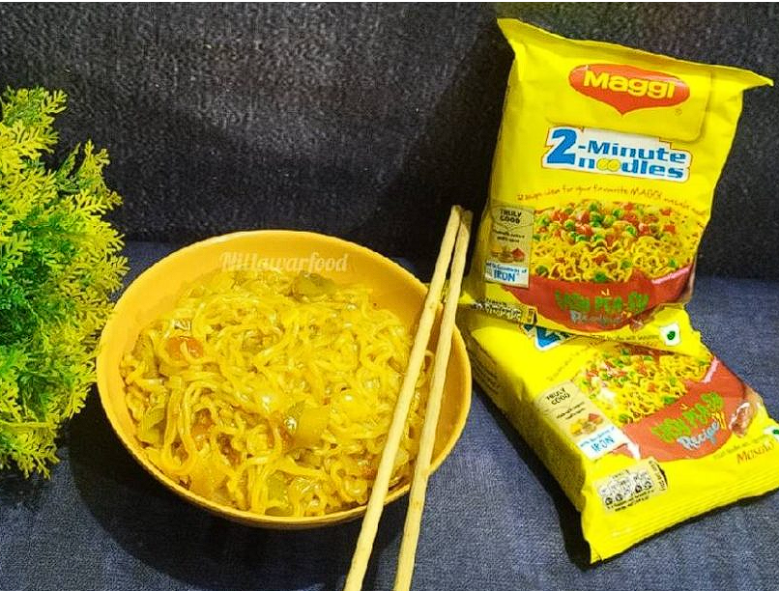
|
Have you ever made Maggi by yourself?
Come on, let's make Maggi today and understand synchronous programming.
‹#›

Slide 4

|
Have you ever made Maggi by yourself?
Come on, let's make Maggi today and understand synchronous programming.
Step 1 – Boil the Water
We must heat water before doing anything else.
Can we add noodles now? No!
We must wait until the water is fully boiled.
‹#›

Slide 5
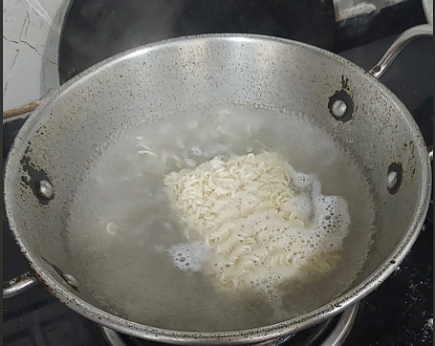
|
Have you ever made Maggi by yourself?
Come on, let's make Maggi today and understand synchronous programming.
Step 2: Add Noodles 🍝
Now that the water is hot, we can add Maggi noodles.
We couldn’t do this earlier, remember?
‹#›

Slide 6
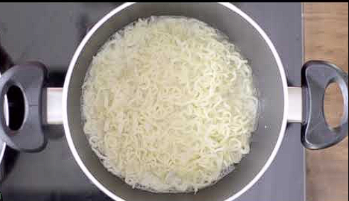
|
Have you ever made Maggi by yourself?
Come on, let's make Maggi today and understand synchronous programming.
Step 3: Stir and Cook 👨‍🍳⏳
Now we stir and let it cook for 2–3 minutes.
We must wait for it to get soft and ready.
‹#›

Slide 7
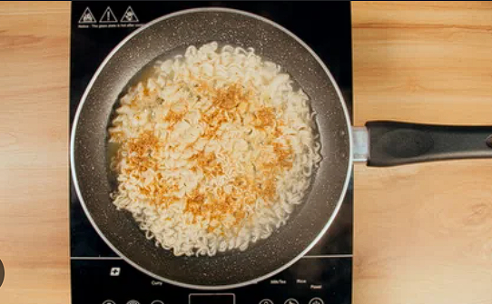
|
Have you ever made Maggi by yourself?
Come on, let's make Maggi today and understand synchronous programming.
Step 4: Add Masala 🧂
Now we sprinkle the tasty masala If we did this earlier, it would float in water!
‹#›

Slide 8

|
Have you ever made Maggi by yourself?
Come on, let's make Maggi today and understand synchronous programming.
Step 5: Serve and Eat! 😋
Now the Maggi is ready. We followed the steps in order, and now we get the reward!
That’s how Synchronous Programming works
‹#›

Slide 9
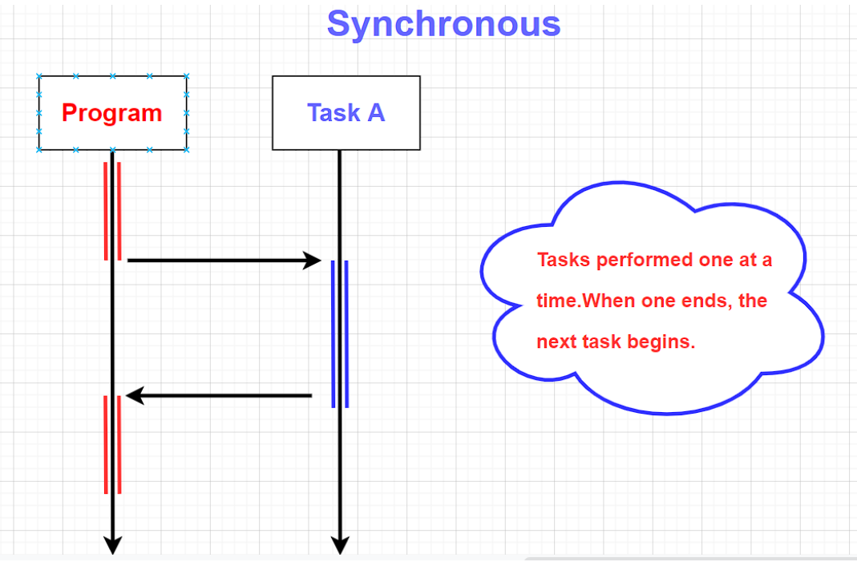
| Synchronous Programming
Now imagine — in Synchronous Programming, each step waits for the previous one to finish.
when we write code, it doesn’t jump around. It starts from the top, completes the first line, then moves to the next one — just like we couldn’t add noodles before boiling the water.
JavaScript is by default a synchronous language.
‹#›

Slide 10
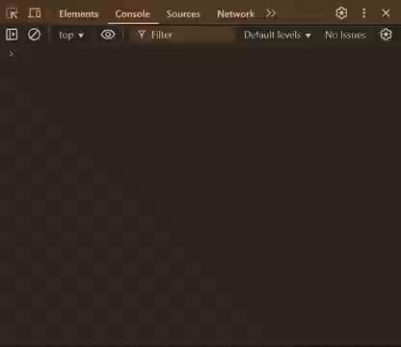
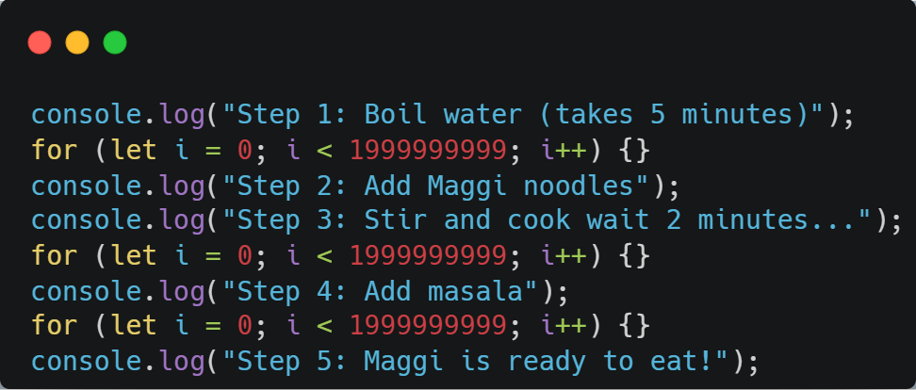
| Synchronous Programming
‹#›

Slide 11

|
Do you know why JavaScript code always runs step-by-step, one line after another? What’s happening behind the scenes that makes it behave like that?
It’s Because of the Single Thread!
A thread is like a worker that performs tasks in a program.
Since JavaScript has only one thread, it can do only one task at a time
‹#›

Slide 12
|
If you have to make Maggi, watch your favorite cartoon, and talk to your best friend on the phone — all at the same time — what will you do?
If you first make Maggi, then watch your cartoon, and only after that talk to your friend — by the time you're done, your cartoon is over, and your friend has already hung up!
Q Then does any smart way ?
So YES — there is a smart way to do all of them without waiting!
‹#›

Slide 13
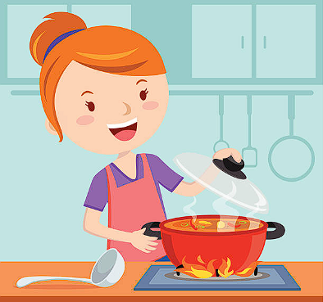
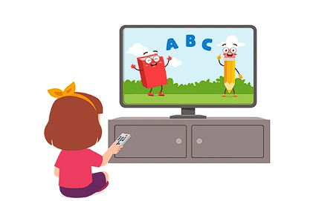

|
If you have to make Maggi, watch your favorite cartoon, and talk to your best friend on the phone — all at the same time — what will you do?
You can start the Maggi and give it to your mom to finish boiling. Then, while she is doing that:
You turn on your favorite cartoon and enjoy it
And at the same time, you talk to your friend on the phone 📞
when the Maggi is ready, your mom calls you: "Beta, Maggi is ready!"
That’s how Asynchronous JavaScript works
Asynchronous work means tasks run independently without waiting for each other.
‹#›

Slide 14
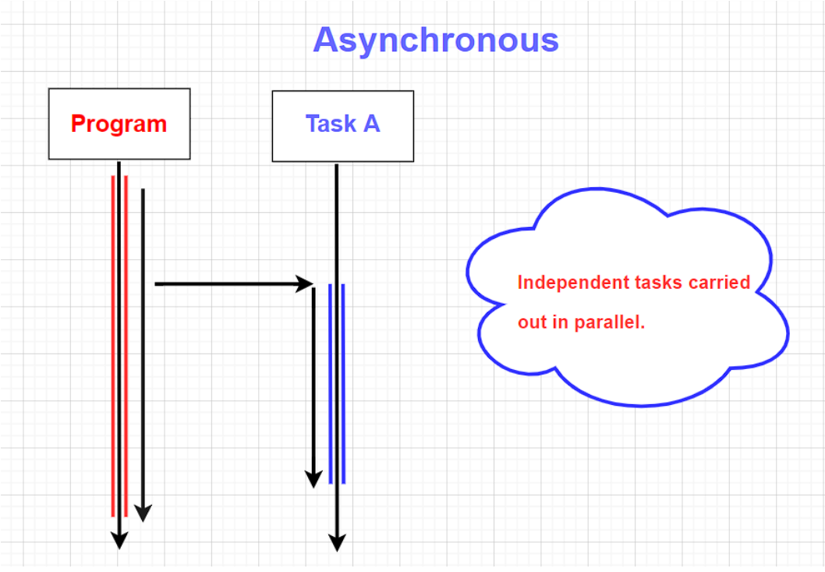
| Asynchronous Programming
Asynchronous programming is a programming technique where certain operations — especially time-consuming ones — are executed in the background,
allowing the rest of the code to continue running without waiting for those operations to finish
JavaScript doesn’t wait for one task to finish — it starts it, and moves on to the next task.
When the first task is done, it comes back and finishes it.
‹#›

Slide 15
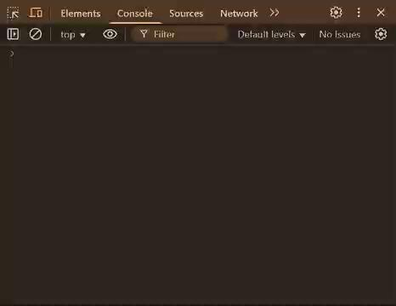
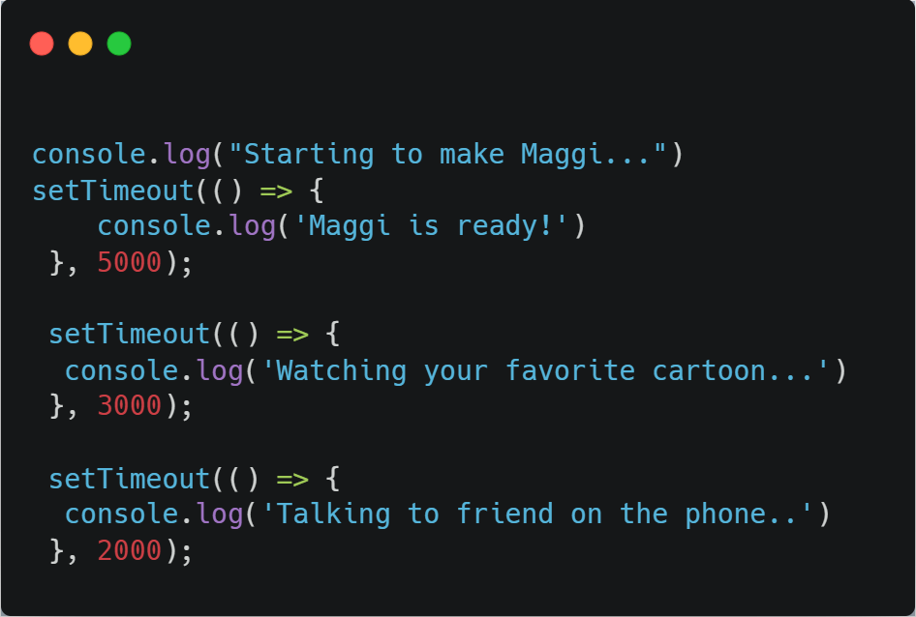
| Asynchronous Programming
‹#›

Slide 16
| Handling Asynchronicity
We know that asynchronous code runs independently, and it doesn’t wait for anything. But what if... one task depends on another?
What if you want one asynchronous task to start only after the previous one finishes?
In real life, you can’t add Maggi before boiling water, right?
Similarly, sometimes in async programming, order matters.
So even though code is asynchronous, we need to force it to run step-by-step — like synchronous
‹#›

Slide 17
| Handling Asynchronicity
We can handle asynchronous code using the following paradigms:
1. Callback Hell:A callback is a function passed as an argument to another function, which is executed after the first one completes.
But when multiple async operations are nested within each other using callbacks, it creates a deeply nested structure called "Callback Hell" — making code difficult to read and maintain
‹#›

Slide 18
| Handling Asynchronicity
We can handle asynchronous code using the following paradigms:
2. Promise :A Promise is an object that represents the eventual result of an asynchronous operation — it either resolves (success) or rejects (failure). Promises allow chaining operations using .then() and handling errors with .catch().
‹#›

Slide 19
| Handling Asynchronicity
We can handle asynchronous code using the following paradigms:
3. Async/Await : async/await is syntactic sugar built on top of Promises. It allows writing asynchronous code that looks and behaves like synchronous code.
The await keyword pauses the execution of the function until the Promise is resolved or rejected.
‹#›

Slide 20
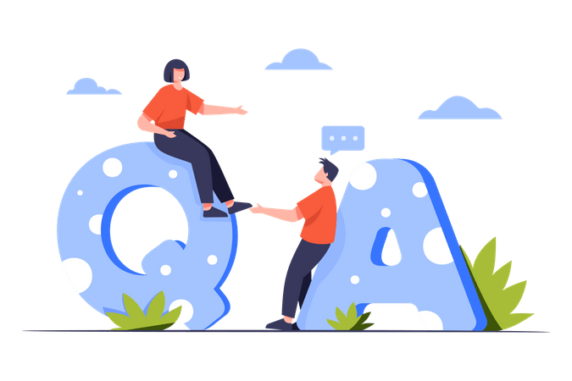
| Check Your Understanding
Question : What is synchronous JavaScript code?
Options : a) Code that runs all at once.
b) Code that runs in the background.
c) Code that is executed line-by-line, one command at a time, in a blocking manner.
d) Code that uses the async keyword exclusively.
Answer : c) Code that is executed line-by-line, one command at a time, in a blocking manner.
Explanation:
Synchronous execution means only one operation can be in progress at a time. Each line of code must wait for the previous line to finish.
‹#›

Slide 21
| Check Your Understanding
Question : Which function schedules a callback to be executed once after a specified delay?
Options : a) setInterval()
b) runAfter()
c) setTimeout()
d) delay()
Answer : c) setTimeout()
Explanation:
setTimeout is a built-in browser API that allows you to schedule a single execution of a function after a given time has elapsed.
‹#›

Slide 22
| Check Your Understanding
Question : What is the primary benefit of using asynchronous code in JavaScript?
Options : a) It makes the code easier to write.
b) It makes the code execute faster overall.
c) It prevents long-running tasks (like network requests or timers) from freezing the user interface.
d) It uses less memory than synchronous code.
Answer : c) It prevents long-running tasks (like network requests or timers) from freezing
the user interface.
Explanation:
Asynchronous code is non-blocking. It allows the browser to remain responsive to user actions while waiting for a time-consuming operation to complete in the background.
‹#›

Slide 23
| References
MDN Web Docs : Comprehensive and official documentation for JS. 🔗https://developer.mozilla.org/en-US/docs/Web/JavaScript
W3Schools – JS Tutorial : Beginner-friendly JS tutorials with examples and interactive editors. 🔗 https://www.w3schools.com/js/
JavaScript.info - A comprehensive tutorial-style website that covers core JavaScript concepts in depth.
🔗https://javascript.info/
‹#›

Slide 24
Thanks
For
Watching
Course - Web Development - II
‹#›
welcome@krmangalam.edu.in
Sohna Road,Gurugram,Haryana 122103

